Slide 1
Discrete Mathematics
Dr. Han Huang
South China University of Technology

Slide 2
Chapter 8. Graphs
Introduction to Graphs
Section 8.1

Slide 3
Contents
1
Types of Graphs
2
Graph Models

Slide 4
Types of Graphs

Slide 5
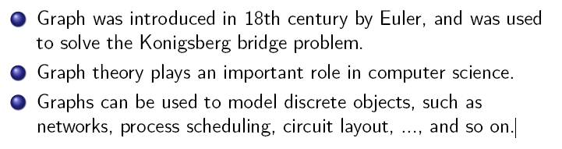
Graphs

Slide 6
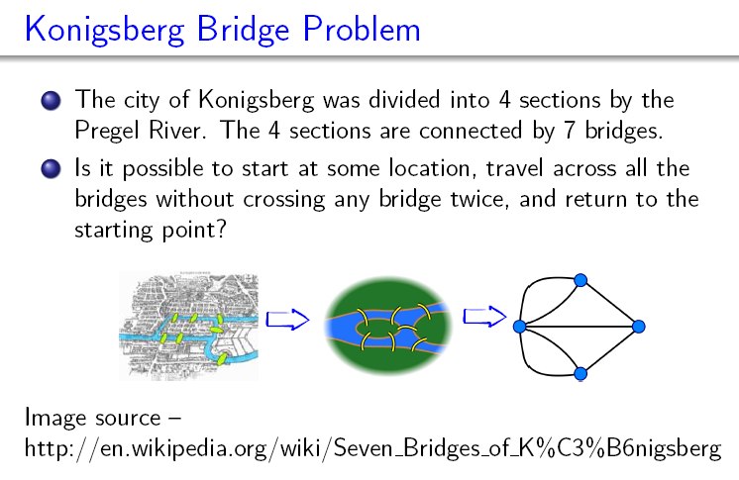

Slide 7
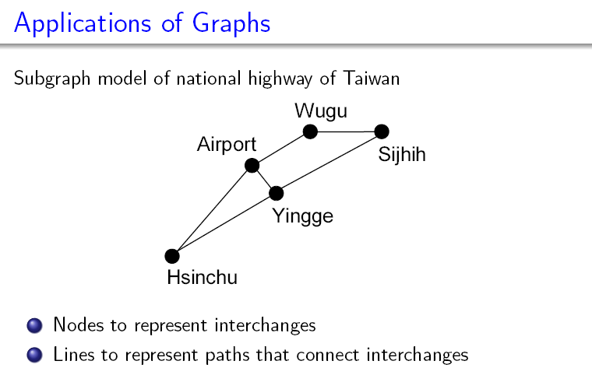

Slide 8
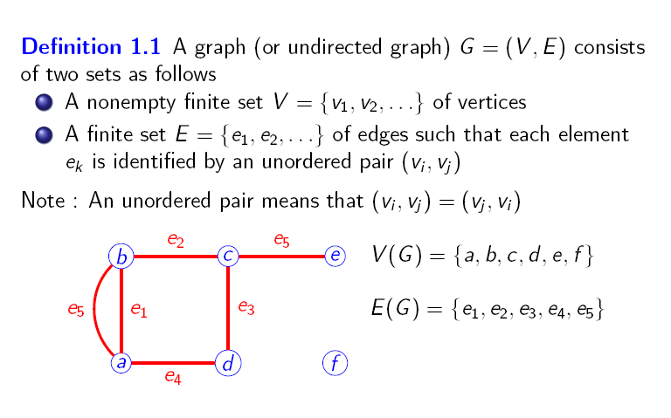

Slide 9
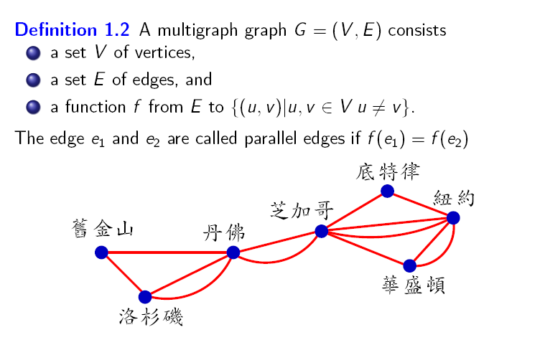

Slide 10
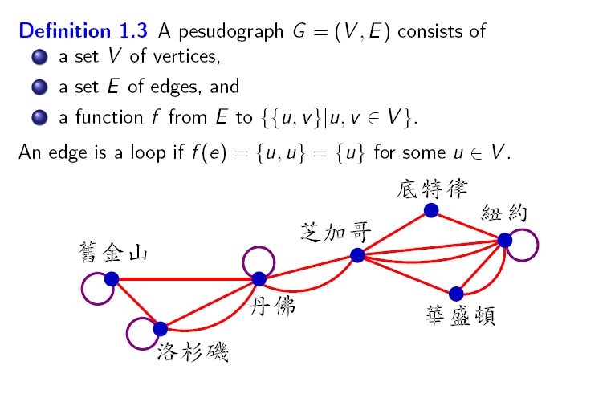

Slide 11
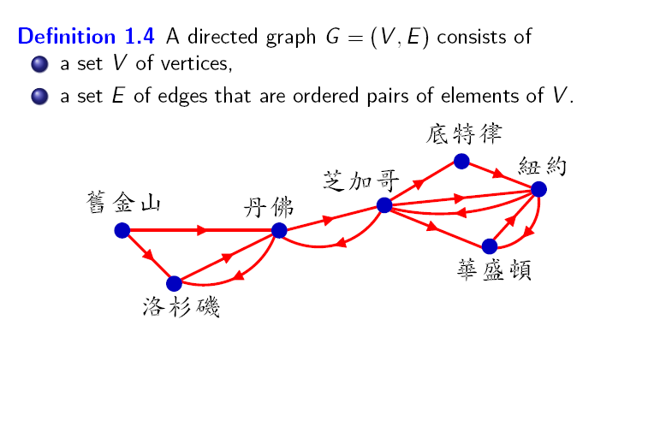

Slide 12
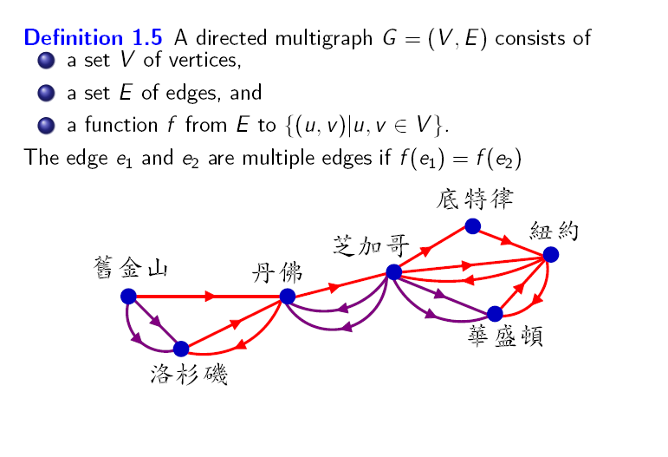

Slide 13
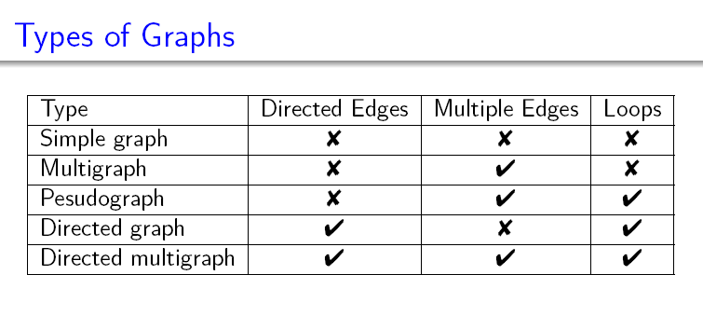

Slide 14
Graph Models

Slide 15
Example 1 Niche Overlap Graphs in Ecology
Raccoon
Hawk
Owl
Opossum
Squirrel
Crow
Shrew
Mouse
Woodpecker

Slide 16
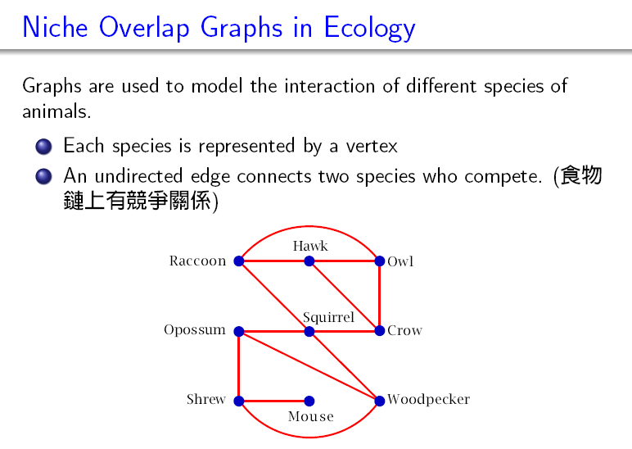

Slide 17
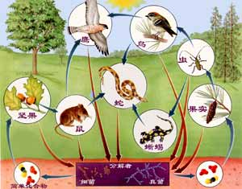
Example 1 Niche Resource Chain 1

Slide 18
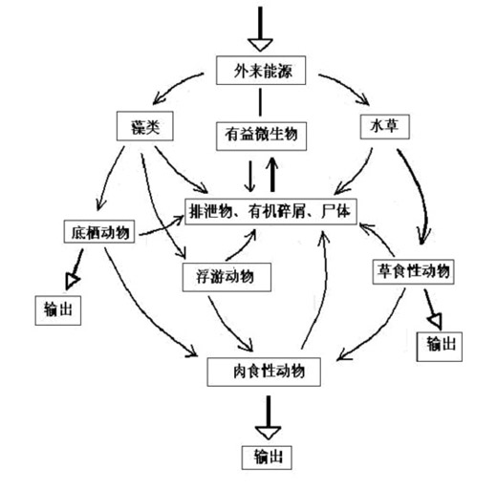
Example 1 Niche Resource Chain 2

Slide 19
Example 2 Acquaintanceship Graphs
Eduardo
Jan
Paula
Todd
Kamlesh
Amy
Kamini
Lila
Liz
Steve
Ching
Joel
Gail
Koko
Kari
Shaquira

Slide 20
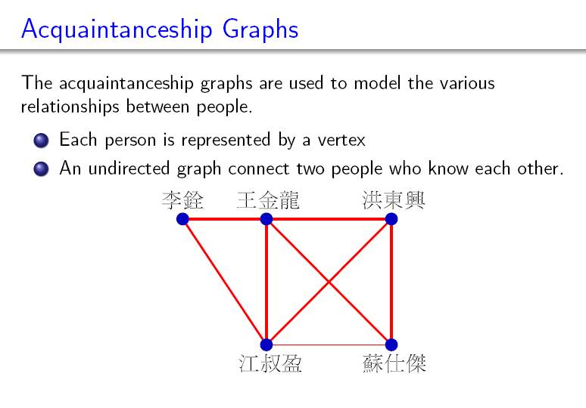

Slide 21
Example 3 Influence Graphs
Linda
Brian
Deborah
Fred
Yvonne

Slide 22
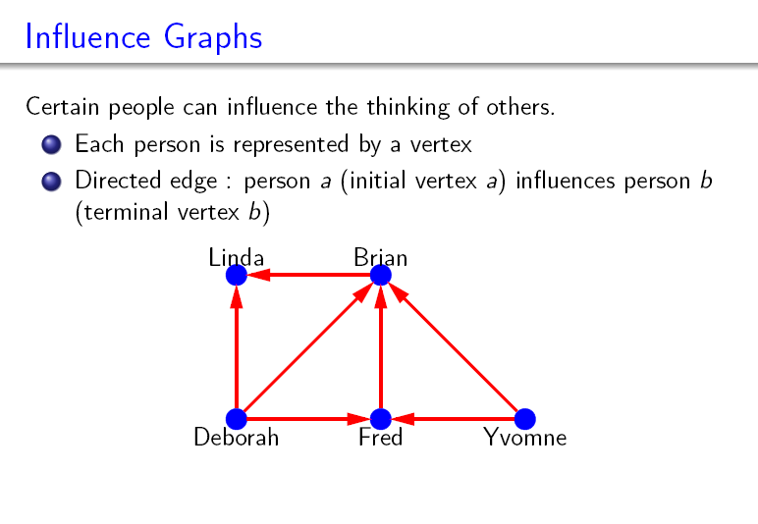

Slide 23
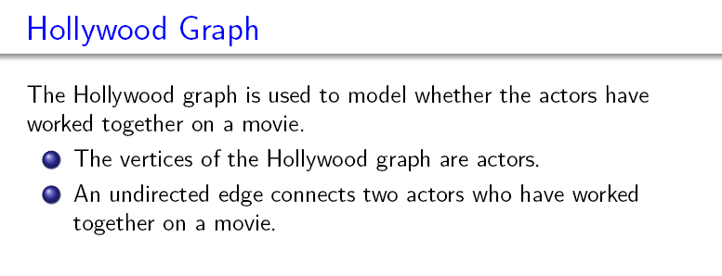
Example 4 The Hollywood Graph

Slide 24
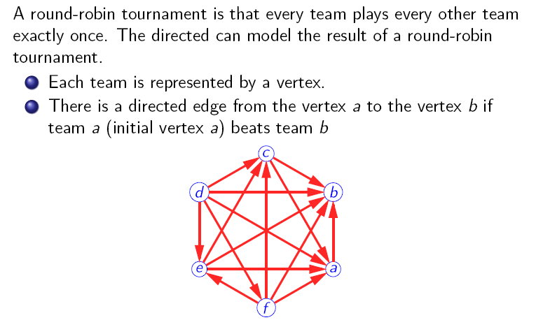
Example 5 Round-Robin Touraments

Slide 25
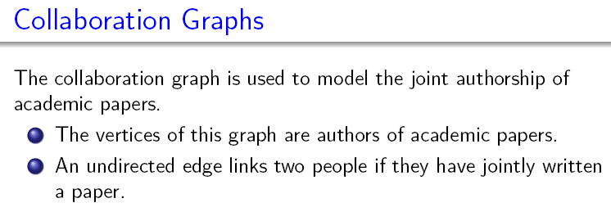
Example 6 Collaboration Graphs

Slide 26
Example 7 Call Graphs
A directed multigraph can be used to model calls where each telephone number is represented by a vertex and each telephone call is represented by directed edge.
The edge representing a call starts at a telephone number from which the call was made and ends at the telephone number to which the call was made.

Slide 27
Example 7 Call Graphs
732-555-1001
732-555-4444
732-555-1234
732-555-0069
732-555-9876
732-555-0011
732-555-6666

Slide 28
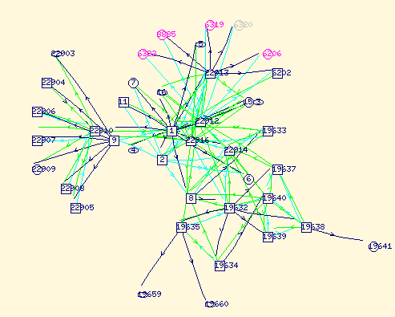
Example 8 The Web Graph
The world wide web can be modeled as a directed graph where each Web page is represented by a vertex and where an edge starts at the Web page a and ends at the Web page b if there is a link on a pointing to b.

Slide 29
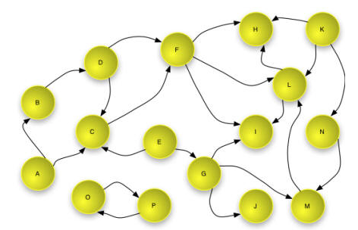
An example of Web Graph

Slide 30
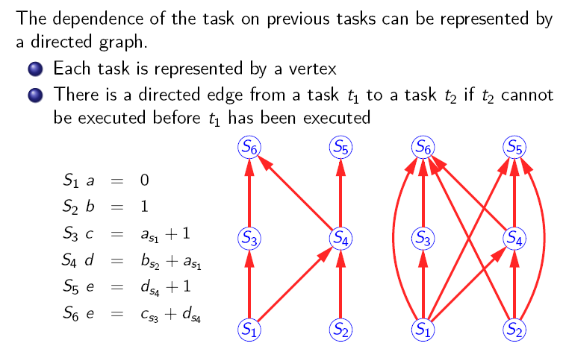
Example 9 A Precedence Graphs

Slide 31
Applications

Slide 32
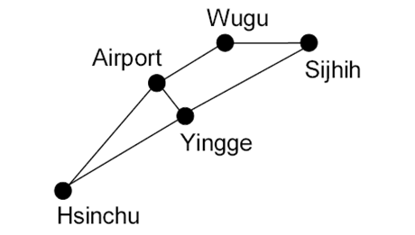
Applications
Tell what type of the graph is?
(simple graph, multigraph, pseudograph, directed graph or directed multigraph)
732-555-1001
732-555-1234
732-555-4444
732-555-0069
732-555-9876
732-555-0011
732-555-6666

Slide 33
Applications
Tell what type of the graph is?
(simple graph, multigraph, pseudograph, directed graph or directed multigraph)
732-555-1001
732-555-1234
732-555-4444
732-555-0069
732-555-9876
732-555-0011
732-555-6666
Simple graph
Directed multigraph

Slide 34
Applications
2. Determine the type of graphs
(simple graph, multigraph, pseudograph, directed graph or directed multigraph)
新浪微博用户，与“关注”关系组成的图。
QQ用户，与“QQ好友”关系组成的图。 (假定自己不属于自己的好友)

Slide 35
Applications
2. Determine the type of graphs.
(simple graph, multigraph, pseudograph, directed graph or directed multigraph)
新浪微博用户，与“关注”关系组成的图。（ directed graph ）
QQ用户，与“QQ好友”关系组成的图。(假定自己不属于自己的好友)（ simple graph ）

Slide 36
End of Section 6.1
Click to edit company slogan .

